Slide 1
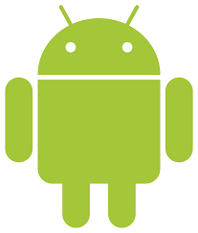



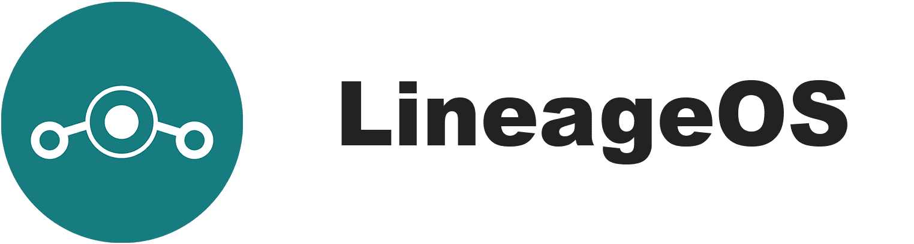



Android Privacy
CorkSec, 2019-11-12
Johannes Ahlmann
/e/ foundation
FossDroid

Slide 2
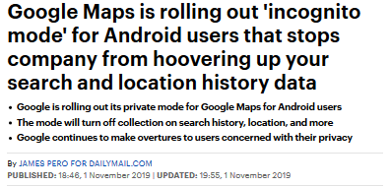
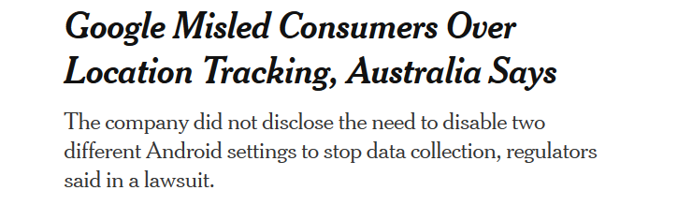
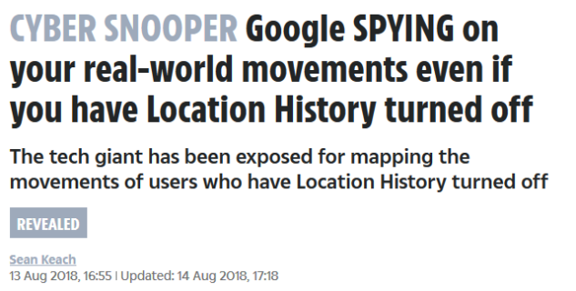
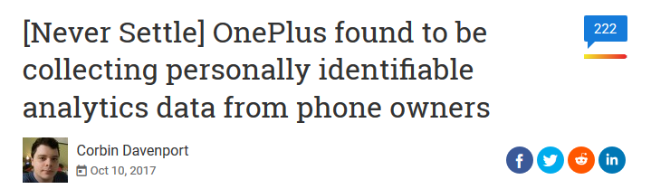
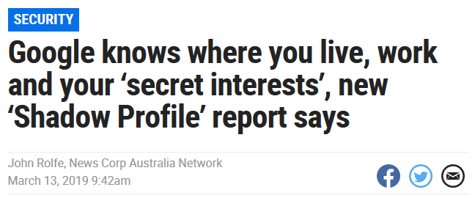
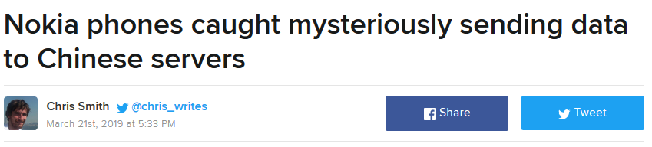
Why the long Face?

Slide 3
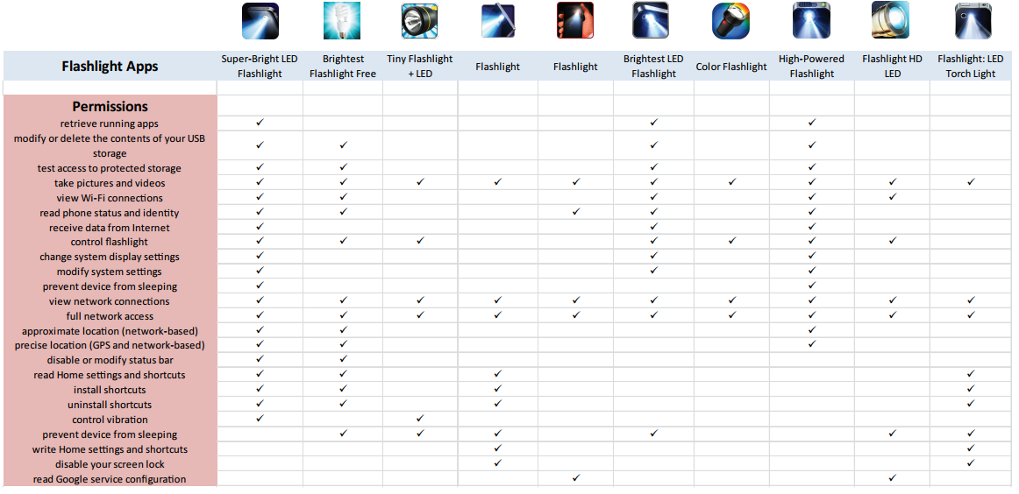
https://www.hackread.com/wp-content/uploads/2014/10/flashlight-apps-stealing-your-personal-information-3.png

Slide 4
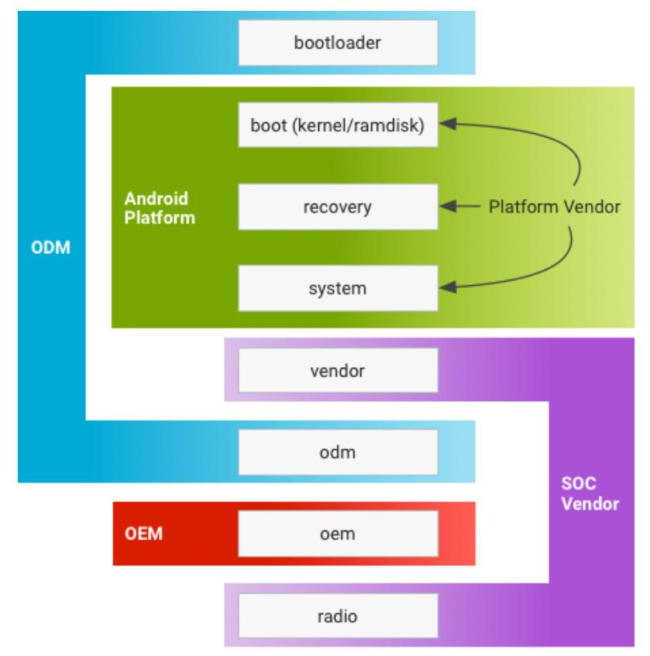
What is Android?
For example:
Google is the Android platform vendor
Qualcomm is the SoC Vendor
Samsung is the OEM/ODM
"Lots of privacy and security is tied to firmware and hardware rather than the OS running on it" - D. Micay
Wifi and cellular SoC have to be considered as their own operating systems.
Notes:
Android 8.0 with Project Treble cleanly splits the partitions up by company.
Typically Google is the Android platform vendor,
Qualcomm is the SoC Vendor (/vendor, /radio),
and a company like Samsung is the OEM/ODM. (/bootloader, /odm, /oem)
You need all sorts of "binary blobs" from chip vendors to make AOSP work.
/system should only contain generic code.
/vendor - SoC specific binaries
/odm - device specific code (HAL)
/oem - assets and customizations
"Devices need to have proper ongoing support for their firmware and software specific to the hardware like drivers in order to provide proper full security updates too."
"[cellular baseband and WiFi] are both radios running firmware that effectively qualifies as a secondary OS"
"How does Graphene protect against attack on firmeware? By carefully choosing hardware targets since the OS is only part of what matters. OS mostly just needs to avoid screwing up IOMMU isolation."

Slide 5
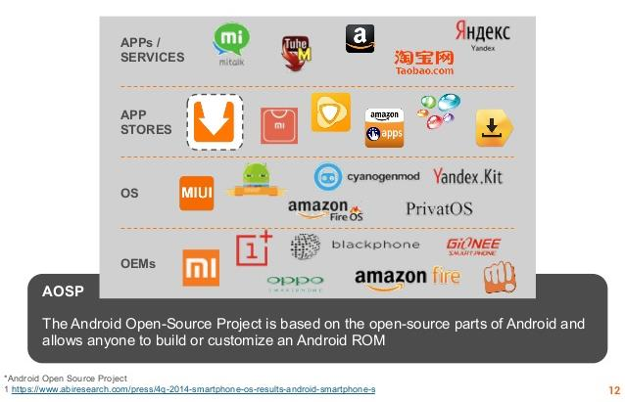
What is Android?
GCM (Google Cloud Messaging)
Google Play, Play Protect
App Store Purchases
FOTA (Firmware Over The Air)
Binary Blobs, Drivers, Blobs

Slide 6
What is the Threat Model?
Physical Access
juice jacking
lost and found
Network-Based (Cellular, WiFi)
exploits
vendor attacks
Who do we want to keep our data from?
Google, Apple
State Actors
Advertisers
Remote Attackers
ODM, OEM, AOSP
Samsung
Google
Apple
Web-Based Remote
Cloud
iCloud
Google
Apps

Slide 7
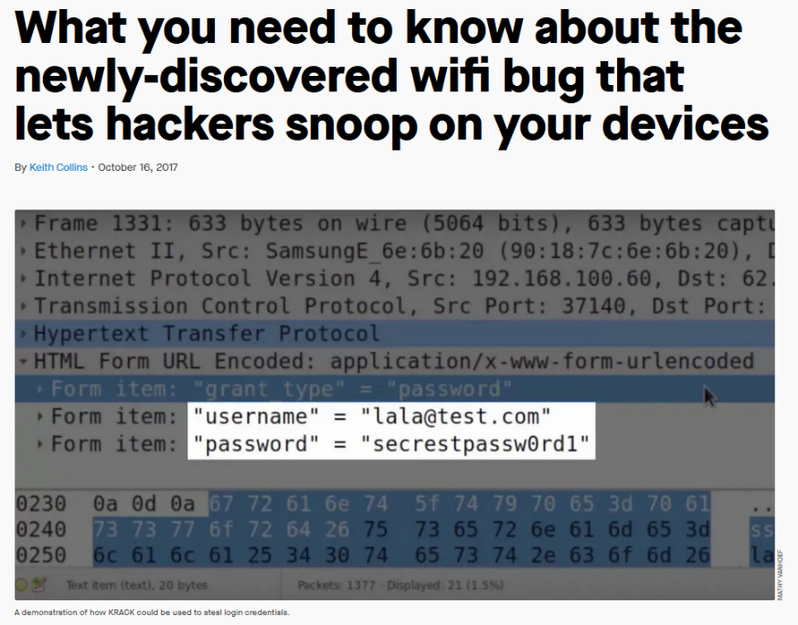
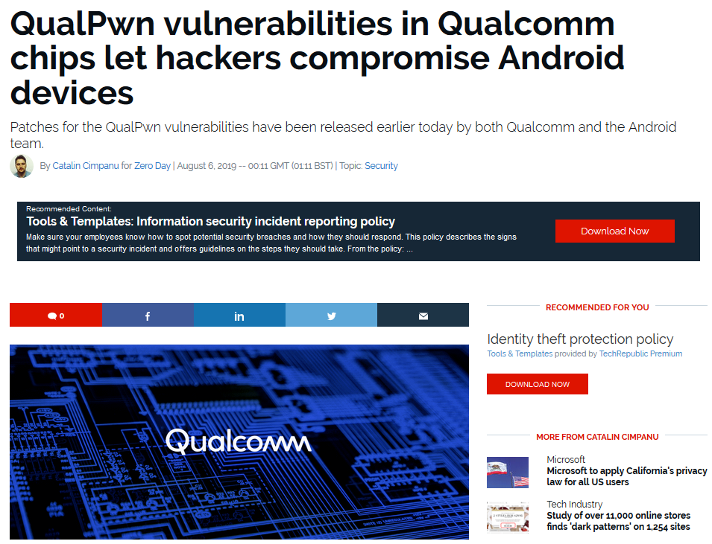
Security - Smartphone vs. Laptop?

Slide 8
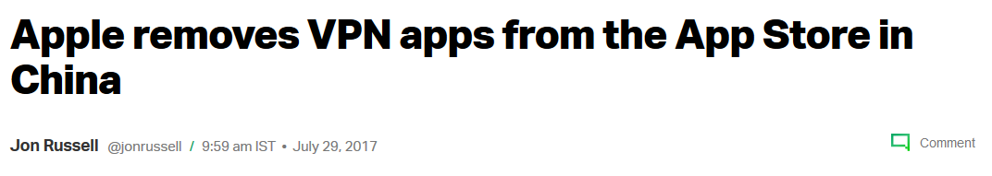

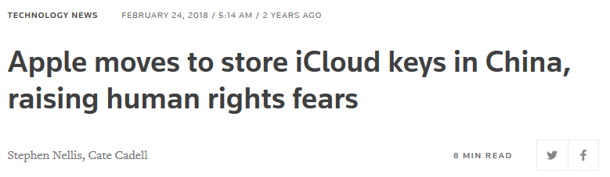

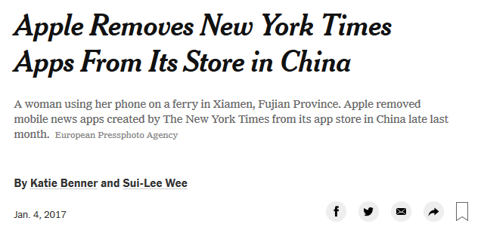
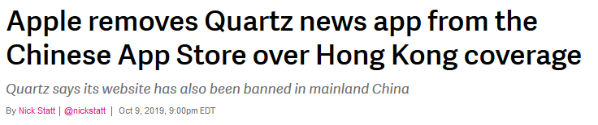
iOS FTW?

Slide 9
iOS FTW?
Consensus that iOS devices provide better privacy for the average user by far
"iOS definitely does still offer better privacy from apps and their services are generally more privacy respecting than Play Services" - D. Micay
Apple's privacy initiative is really impressive!
But we need to trust Apple to act in our best interest, and features can be removed at any time.
Walled Garden (censorship, future-proofing, side-loading)
"The only real alternative [to AOSP] is buying an iPhone" - D. Micay
Snowden never endorsed iOS because of Apple's intense collaboration with intelligence agencies for mass surveillance

Slide 10




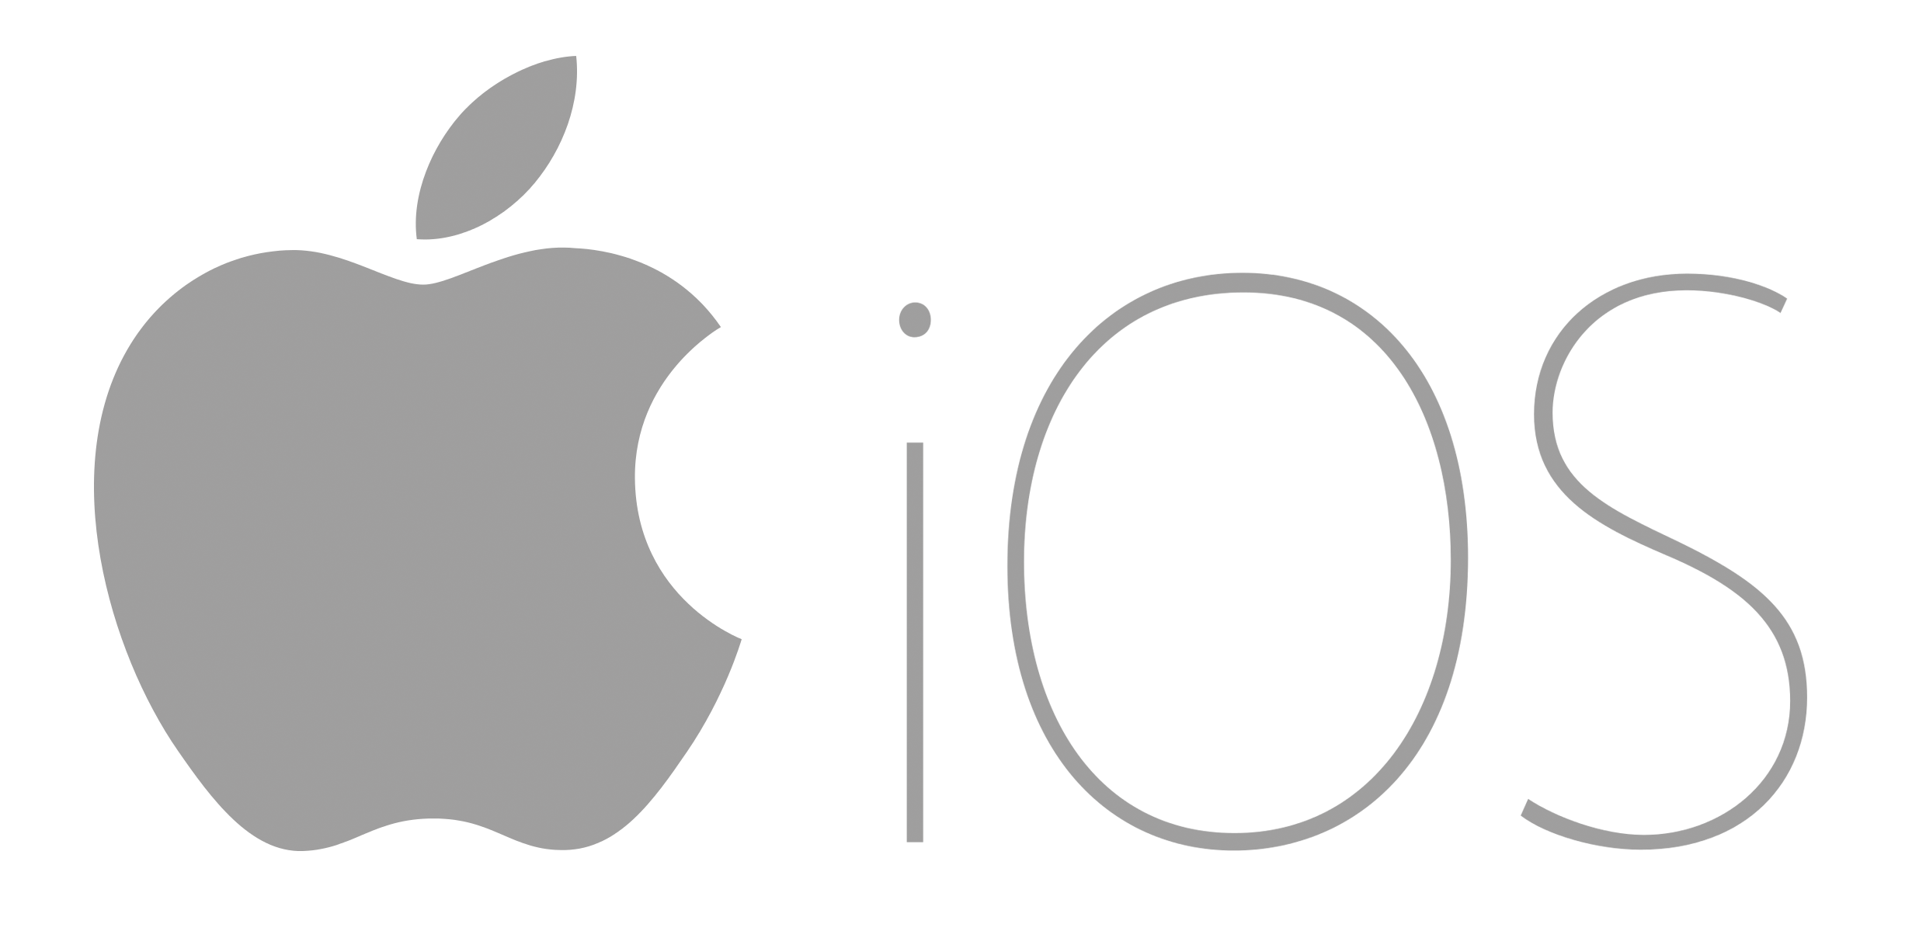




What are our options?
/e/ foundation

Slide 11

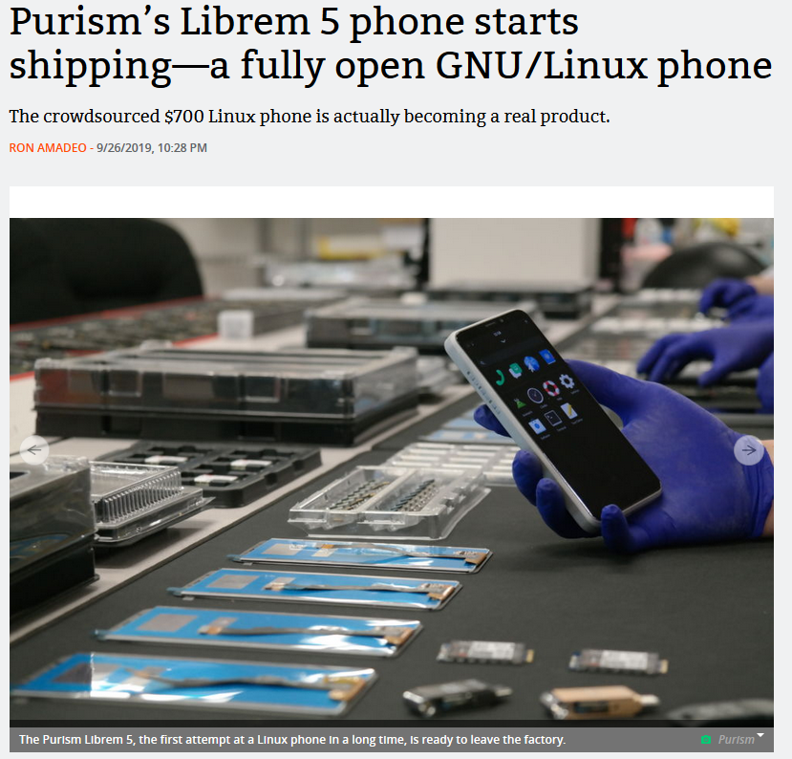
Librem 5 phone - low specs, $699
Hardware toggles for wifi, cellular, etc.
No support for android hardware
Low app availability
Hard to catch up on AOSP hardening efforts from stock linux (source)

Slide 12
Foundation, for microG
Danial Micay:
Weakens the SELinux policies
Rolls back mitigations for device porting / compatibility
Disables verified boot
Lacks proper update security including rollback protection
Adds substantial attack surface like FFmpeg alongside libstagefright, etc.
Merge in huge amounts of questionable, alpha quality code from the Code Aurora Forum repositories too.
Many supported devices (including Nexus and Pixel phones) also don't get their full firmware updates shipped by LineageOS.
InfoSec Handbook review

Slide 13
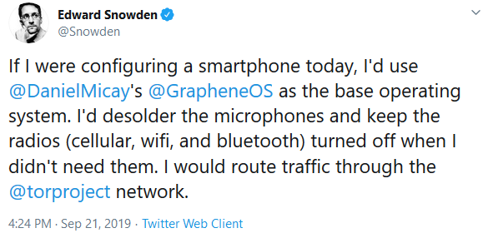

Slide 14
Based on AOSP
Only support Pixel 2 and Pixel 3 devices
Locked Bootloader, Verified Boot
It's focused on privacy and security hardening rather than device support (source)
Can be built "easily" from source and self-signed
Experience
Great apps on F-Droid
Aurora app store works great
Notifications won't work for most apps
Workable as a daily driver

Slide 15


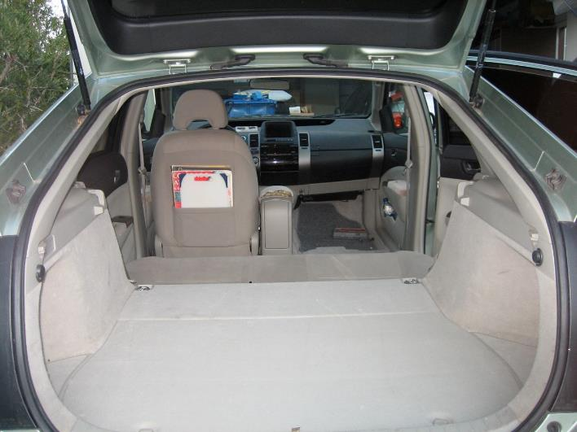


Slide 16
TL;DR
Device support is a mess (Lineage, GrapheneOS)
Pixel 2 XL: ~150GBP
Oneplus 5t: ~150GBP
Pixel 3a: ~270GBP (335EUR new)
With microG notifications work better, but still not perfect
Are notifications strictly necessary, and are they good for us?
Its only "encrypted" if you own the keys, or can prove that noone else does!
Open Source protects us from functionality being taken away from one day to the next, and gives us a modicum of control
Use stock AOSP/ GrapheneOS on a Pixel 3. Otherwise go with iOS!

